Slide 1
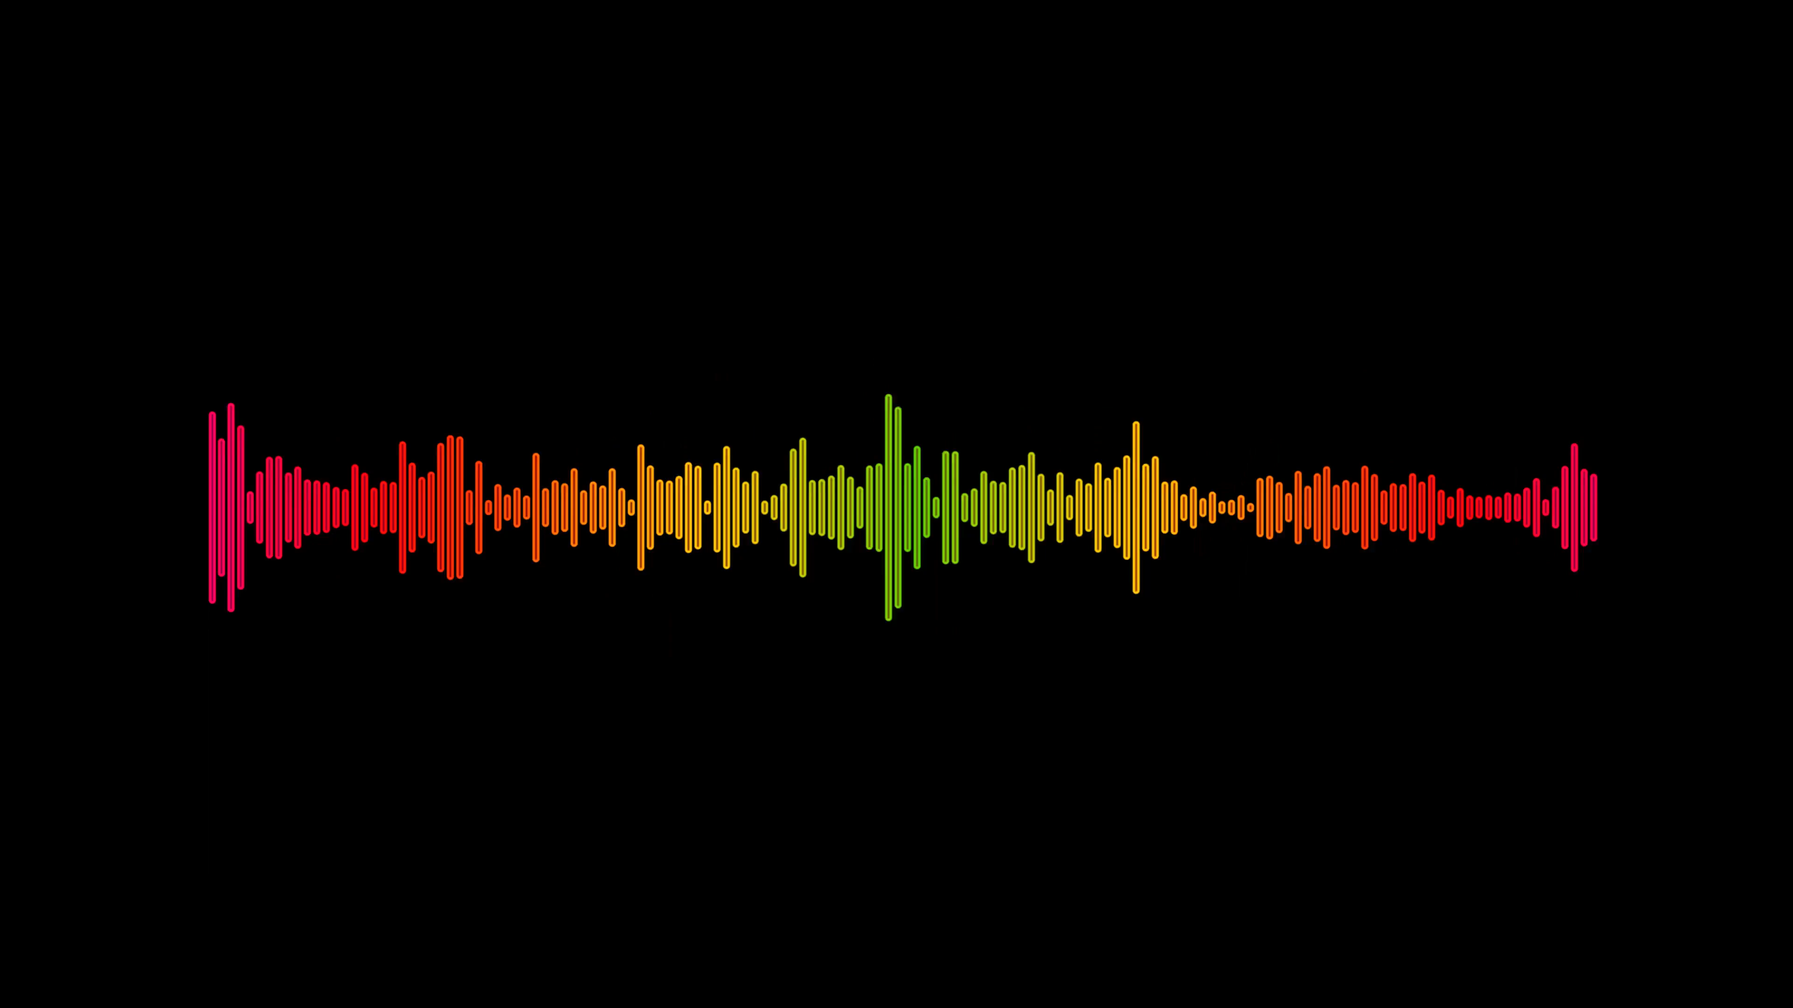
The_Saviours
Latchireddi Ekalavya(20203086)
Ippili Gunavardhan(20203068)
Konigeti Abhidev(20203077)
Kandukuri Yaswanth(20201057)
Will
Decode the Information

Slide 2


Decode the Information
Libraries Used:
JSON
Numpy
Sklearn.model_selection
Tensorflow - Keras
Matplotlib
Librosa
Math
Speech_recognition
Pydud

Slide 3
Decode the Information
Process followed to save the earth
Extracting MFCC values of training audios using librosa
Training the audios using keras with MFCC values
Predicting the test audios
Separating the persons using prediction values
Converting the audio into text using speech recognition

Slide 4
Decode the Information
Extracting MFCC values
Paths of each training files are extracted by using OS
Separated the song into segment(1sec audio as 1 segment)
MFCC values of each segment are extracted using librosa
Added the labels
Stored the MFCC of each segment in json file

Slide 5
Decode the Information
Training
Extracted the MFCC and their labels from json file to train
Splited the extracted data for training and testing using train_test_split in sklearn
Developed the keras sequential model with one input layer ,three hidden layers and one output later
For hidden layers relu activation function is used and for output layer softmax is used
Model is trained with 'adam' optimizer

Slide 6
Decode the Information
Prediction
MFCC of each segment of test_audio are extracted
Predicted each segment and stored in an array
Persons and time are separated using the predicted values

Slide 7
Decode the Information
Decoding the Audio
Test audio is splitted with separated timings using audio segment library
Each separated audio is divided into chunks by removing silence
These chunks are translated into text one by one using speech recognition library

Slide 8
Decode the Information
Problems faced during decoding
During training ,since each audio contains silences. We can't differentiate silence by predicting because silent is same for all .this problem is overcame by neglecting the audios which are less than 5sec, this 5sec we can say the average time of silence in each wave
Some of the chunks from the audios which you are given are unable to decode using speech recognition , this may be due to fast speaking

Slide 9
Decode the Information
Thank You

Slide 10
Decode the Information
ANY DOUBTS?

